Slide 1
Customer Churn Prediction

Slide 2
BUSINESS UNDERSTANDING
The goal of this project is to develop a predictive model to identify customers at risk of churning, enabling companies to adopt effective strategies for retaining existing customers. This is particularly important in the highly competitive telecommunication industry, where customer movement between service providers can significantly impact profitability. Retaining customers is less expensive than acquiring new ones or up-selling, making it a critical focus for businesses aiming to maximize profits and sustain long-term growth.

Slide 3
Business Goals
Reduce Customer Churn
Identify high-risk customers using historical data and behavioural patterns like complaints or reduced usage. Proactively address dissatisfaction to minimize churn and retain revenue, as retaining customers is more cost-effective than acquiring new ones.
Enhance Customer Retention
Deploy targeted strategies such as personalized offers, loyalty rewards, and prioritized customer support to address concerns and improve customer experience.
Improve Customer Satisfaction and Loyalty
Address dissatisfaction factors like poor service quality and unresponsive support by enhancing service reliability, resolving issues promptly, and offering transparent pricing. Use feedback systems to implement improvements, fostering loyalty and turning at-risk customers into advocates.

Slide 4
Current Situation Assessment
1. Industry Overview and Churn Challenges The telecommunication industry faces heightened competition due to globalization and technological advances, increasing customer churn risks. Companies must evaluate retention strategies and address gaps in service quality and customer engagement to stay competitive.
2. Importance of Early Churn Detection Despite access to rich customer data (e.g., transaction histories, usage patterns), many companies lack robust systems for early churn detection, missing opportunities for proactive interventions to improve satisfaction and retention.
3. Dataset Overview The dataset contains 10,000 records with 11 attributes, including:
Demographics: Age, gender, tenure.
Financial Metrics: Credit score, balance, estimated salary.
Product & Activity: Products used, account activity, credit card status.
Churn Label: Indicates churn status (1: churned, 0: retained).

Slide 5
Potential Risks
Class Imbalance
Churn datasets often have more non-churners than churners, causing biased predictions. Address this with techniques like oversampling, under sampling, or class-weighted loss functions to improve model performance.
Data Quality and Preprocessing
Issues like missing values, noise, and irrelevant features can reduce model accuracy. Preprocessing steps such as data cleaning, normalization, outlier detection, and feature selection are critical to enhance efficiency and accuracy..
Reactive vs. Proactive Challenges
Proactive churn management is ideal but complex. False positives may waste resources on unnecessary retention, while false negatives risk losing customers. Balancing these is crucial for effective strategy implementation.

Slide 6

DATA UNDERSTANING
Objective:
The objective of this phase is to collect and familiarize yourself with the dataset, determine its quality, gain insights, and identify any potential issues that could impact analysis or modelling efforts. This step is crucial for determining the suitability of the data for the modelling phase and ensuring it aligns with the business problem.
Data Description:
Shape: The dataset contains 10,002 rows and 14 columns, comprising both numeric
and categorical features.

Slide 7
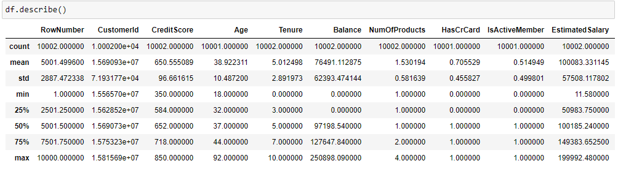
DATA UNDERSTANING
Summary Statistics:
A summary of the numerical features was generated using df.describe(), which highlights the following key statistics for the dataset:
The dataset's numerical features highlight varied customer profiles: CreditScore ranges from 350 to 850, averaging around 650, indicating diverse creditworthiness; Age spans 18 to 92 years, with a mean in the mid-30s to 40s; Balance shows significant variation, from 0 to over 200,000; EstimatedSalary ranges from nearly 0 to over 200,000, averaging approximately 100,000; and Tenure spans 0 to 10 years, reflecting varying lengths of customer relationships.

Slide 8
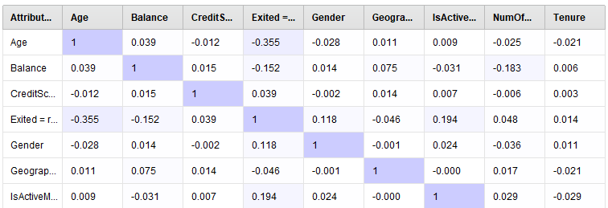
DATA UNDERSTANING
Correlation results:

Slide 9
DATA UNDERSTANING
Data Quality Check Summary:
Missing Values: The HasCrCard column contains missing values, to be addressed during preprocessing.
Data Types: Columns were categorized into categorical (e.g., proto, service) and numerical (e.g., dur, spkts, rate), guiding preprocessing strategies.
Outliers: Numerical features (e.g., CreditScore, Age, Balance) were inspected for outliers; further investigation is needed for extreme values.
Consistency: No inconsistencies were detected in categorical data (Geography, Gender). The target variable (Exited) contains only valid binary values (0, 1).Irrelevant Features: Columns like RowNumber, CustomerId, and Surname were flagged for removal.

Slide 10
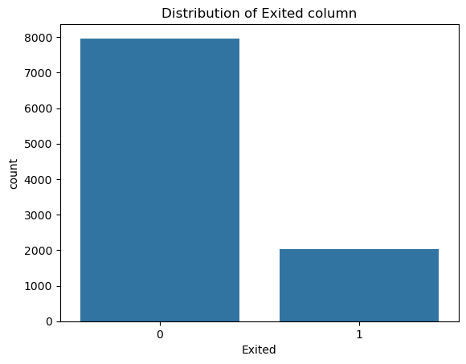
DATA UNDERSTANING
Target Distribution: The Exited column shows imbalance (7,963 non-churn vs. 2,037 churn). Resampling techniques or class weighting will address this during model training.

Slide 11
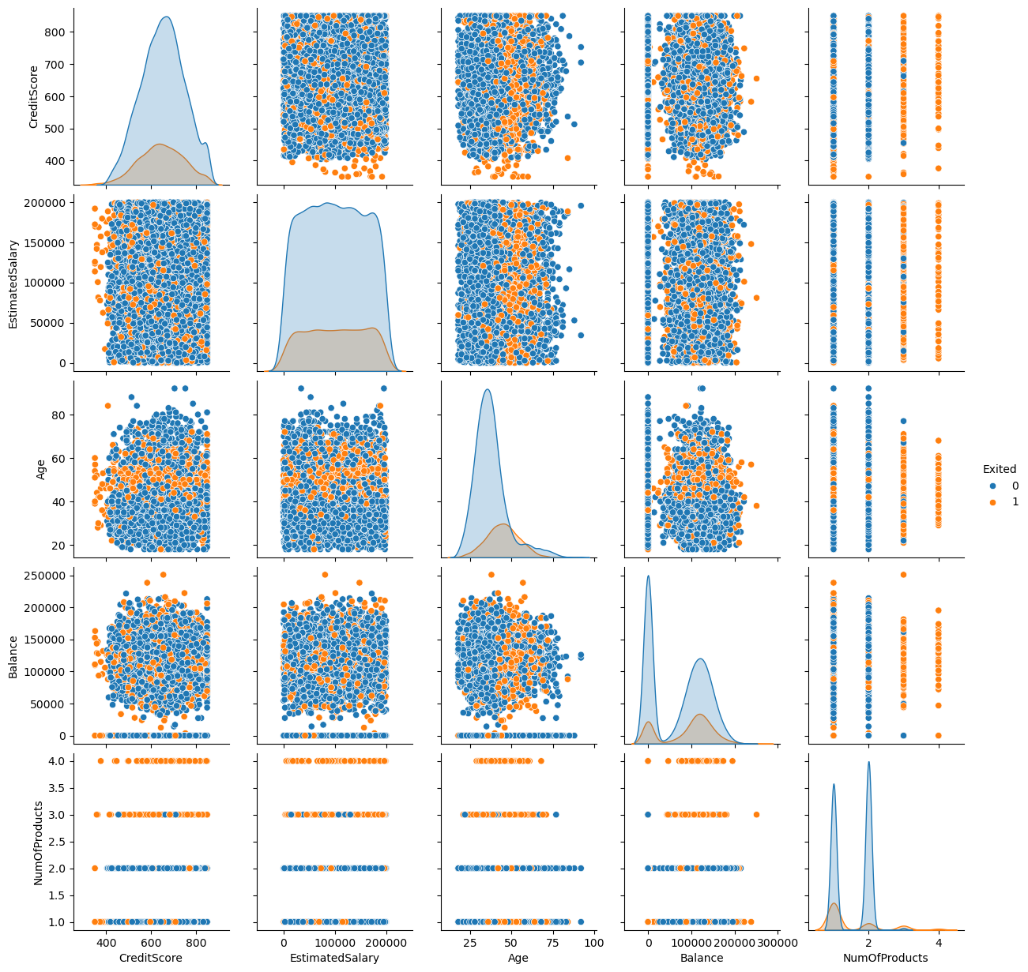
DATA UNDERSTANING
Exploratory Data Analysis (EDA):
Pair plot: A pairplot was created to explore relationships between features (CreditScore, EstimatedSalary, Age, Balance, and NumOfProducts) and the target variable Exited. It highlights patterns or clusters distinguishing churned customers (Exited = 1) from non-churned (Exited = 0).

Slide 12
DATA PREPARATION
Objective:
Ensure the dataset is clean, well-structured, and ready for modeling by addressing missing values, encoding categorical variables, and selecting relevant features.
Key Tasks:
Data Cleaning: Handling Missing Values: Missing rows were removed using df.dropna(axis=0) to ensure data integrity and prevent issues during model training. This reduced dataset size slightly but improved reliability and consistency.
Analysis of Categorical Features and Class Distributions: The dataset's categorical features were analyzed to understand their distributions and provide valuable insights into customer demographics and behaviors. The value_counts() function was applied to attributes such as Surname, Geography, Gender, and Exited.

Slide 13
DATA PREPARATION
Dropping Un-necessary columns from the dataset: Irrelevant columns, such as RowNumber, Surname, and CustomerId, were dropped using df.drop(), retaining only features essential for prediction.
Feature Selection: Feature selection is a technique used to choose the most important and relevant features for training the model. This helps in reducing the complexity of the model, improving model accuracy, and preventing overfitting.
Resulting Dataset: The final dataset contains 11 columns, including numerical features like CreditScore, Age, Balance, and encoded categorical features such as Geography and Gender. The balanced dataset is ready for use in the modeling phase, ensuring fairness and accuracy during training.
Splitting the Data:The dataset was split into training (80%) and testing (20%) sets using Scikit-learn's train_test_split, with a fixed random state for reproducibility. Features (X) and the target (Exited) were separated to ensure proper training and evaluation for robust performance.

Slide 14
MODELING
objective: The primary goal in model selection was to identify a machine learning algorithm that could deliver high accuracy while efficiently handling complex data structures, class imbalances, and potential overfitting. Given the critical nature of accurate classification, the focus was on an algorithm that could adapt well to varied data distributions and ensure robust generalization.
Selection of Modelling Techniques:
A range of supervised and unsupervised learning methods was employed, including Gradient Boosted Trees, Deep Learning, Random Forest, Logistic Regression, Naive Bayes, and Decision Tree classifiers.

Slide 15
MODELING
MODEL | Accuracy | Standard Deviation | Gains | Total Time | Training Time | Scoring Time
Naive Bayes | 0.715259 | 0.005346 | 1958 | 52089 | 15.57789 | 224.5603
Generalized Linear Model | 0.687336 | 0.002125 | 1704 | 56999 | 46.73367 | 200.5339
Logistic Regression | 0.686676 | 0.001923 | 1698 | 55150 | 17.90201 | 145.7286
Fast Large Margin | 0.608924 | 0.010153 | 990 | 83166 | 152.4497 | 143.3731
Deep Learning | 0.777754 | 0.003291 | 2526 | 106061 | 416.7714 | 228.0151
Decision Tree | 0.698396 | 0.008939 | 1804 | 60688 | 13.94472 | 141.8028
Random Forest | 0.737465 | 0.01052 | 2160 | 236086 | 22.86432 | 472.6759
Gradient Boosted Trees | 0.814686 | 0.007397 | 2862 | 310644 | 293.4045 | 590.9234
RESULTS FROM RAPID MINNER:
Model Comparison Based on Accuracy:
Using RapidMiner, Gradient Boosted Trees achieved the highest accuracy (81.47%), followed by Deep Learning (77.78%). Random Forest performed well (73.75%), while Naive Bayes (71.53%) and Logistic Regression (68.67%) were suitable for simpler tasks. Generalized Linear Model (68.73%) and Decision Tree (69.84%) showed moderate performance, while Fast Large Margin had the lowest accuracy (60.89%).

Slide 16
MODELING
MODEL | Precision | Standard Deviation | Gains | Total Time | Training Time | Scoring Time
Naive Bayes | 0.74767 | 0.008592 | 1958 | 52089 | 15.57789 | 224.5603
Generalized Linear Model | 0.651945 | 0.002558 | 1704 | 56999 | 46.73367 | 200.5339
Logistic Regression | 0.651573 | 0.002521 | 1698 | 55150 | 17.90201 | 145.7286
Fast Large Margin | 0.611217 | 0.007327 | 990 | 83166 | 152.4497 | 143.3731
Deep Learning | 0.754876 | 0.00738 | 2526 | 106061 | 416.7714 | 228.0151
Decision Tree | 0.825588 | 0.015412 | 1804 | 60688 | 13.94472 | 141.8028
Random Forest | 0.775983 | 0.01422 | 2160 | 236086 | 22.86432 | 472.6759
Gradient Boosted Trees | 0.792466 | 0.007527 | 2862 | 310644 | 293.4045 | 590.9234
RESULTS FROM RAPID MINNER:
Model Comparison Based on Precision
Based on the results from the RapidMiner analysis, for tasks requiring the highest precision, Decision Tree and Gradient Boosted Trees are the best options. Random Forest and Deep Learning also perform well, with moderate computational demands. Models like Naive Bayes balance precision and efficiency, while Logistic Regression, Generalized Linear Model, and Fast Large Margin are less optimal.

Slide 17
MODELING
Model | Recall | Standard Deviation | Gain | Total Time | Training Time | Scoring Time
Naive Bayes | 0.649954 | 0.005622 | 1958 | 52089 | 15.57789 | 224.5603
Generalized Linear Model | 0.803869 | 0.007218 | 1704 | 56999 | 46.73367 | 200.5339
Logistic Regression | 0.80255 | 0.006676 | 1698 | 55150 | 17.90201 | 145.7286
Fast Large Margin | 0.597614 | 0.027175 | 990 | 83166 | 152.4497 | 143.3731
Deep Learning | 0.822781 | 0.013399 | 2526 | 106061 | 416.7714 | 228.0151
Decision Tree | 0.503074 | 0.016235 | 1804 | 60688 | 13.94472 | 141.8028
Random Forest | 0.667987 | 0.016426 | 2160 | 236086 | 22.86432 | 472.6759
Gradient Boosted Trees | 0.852685 | 0.015586 | 2862 | 310644 | 293.4045 | 590.9234
RESULTS FROM RAPID MINNER:
Model Comparison Table (Recall)
Gradient Boosted Trees had the highest recall (85.27%), followed by Deep Learning (82.28%). Generalized Linear Model (80.39%) and Logistic Regression (80.25%) performed reliably. Random Forest (66.80%) and Naive Bayes (64.99%) showed moderate recall, while Fast Large Margin (59.76%) and Decision Tree (50.31%) struggled. Gradient Boosted Trees and Deep Learning are best for recall-focused tasks..

Slide 18
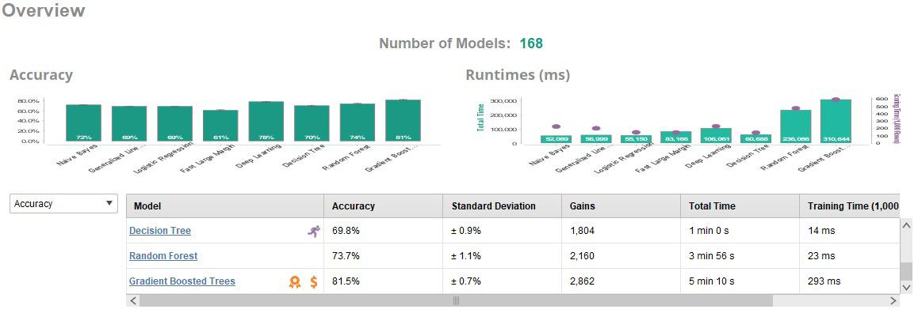
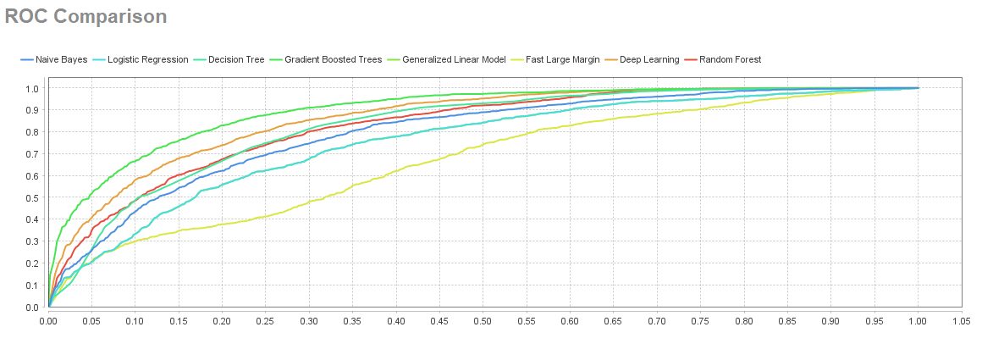
MODELING
ACCURACY COMPARISON
ROC COMPARISON OF EACH MODEL

Slide 19
MODELING
Model Selection:
The XGBoost Classifier (XGBClassifier) was selected for this task due to its well-documented ability to handle large datasets and having the best accuracy among other machine learning models that effectively mitigate overfitting and optimize model accuracy through gradient boosting. XGBoost’s strength lies in its iterative training approach, where each new model corrects the errors of the previous ones, making it a top choice for high-stakes classification problems.
Model Training:
The model was trained using the scaled and selected feature dataset:
Training Dataset: X_train_scaled_sel_features (features) and y_train_sel_features (target labels).
The fit () method was used to learn patterns from the training data.

Slide 20
EVALUATION
The XGBoost model's effectiveness in predicting customer churn was evaluated to ensure alignment with business goals and readiness for deployment.
Accuracy Assessment: The model achieved 88.85% accuracy on the test dataset, demonstrating strong performance in identifying patterns. However, due to class imbalance in churn prediction, additional metrics were considered:
Precision: Ensures minimal false positives.
Recall: Measures the ability to identify all churned customers.
F1-Score: Balances precision and recall, critical for imbalanced data scenarios.

Slide 21
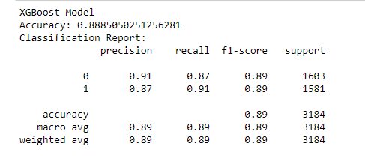
EVALUATION
The XGBoost model's effectiveness in predicting customer churn was evaluated to ensure alignment with business goals and readiness for deployment.
Precision, Recall, and F1-Score Evaluation:

Slide 22
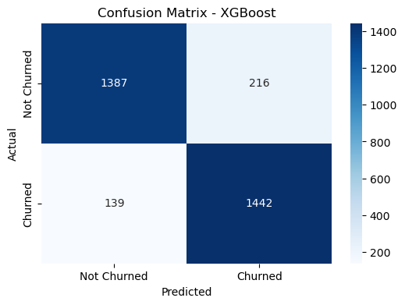
5 EVALUATION
Confusion Matrix Evaluation: The XGBoost model correctly classified 87% of non-churned (Class 0) and 91% of churned customers (Class 1). Misclassifications were minimal, with few false positives and false negatives..
Confusion Matrix Analysis:

Slide 23
6 DEPLOYMENT
Objective:
The goal is to deploy the XGBoost model in a real-world environment to provide actionable insights, ensuring accessibility, integration, and ongoing monitoring.
Deployment Plan: Platform: Host on a cloud platform (AWS/Azure) for scalability
Integration: Link the model to the CRM system for real-time data processing.
User Accessibility: Develop a web interface or API for user interaction.
Model Integration and Automation: Wrap the model in an API (Flask/FastAPI) for on-demand predictions.
Automate data preprocessing, model interaction, and results presentation.
Create a dashboard to display predictions and insights.

Slide 24
DEPLOYMENT
Monitoring and Maintenance:
Track performance metrics regularly and monitor for data drift
Set up alerts for performance issues and establish retraining processes.
Validation in Production:
Test in a simulated environment before gradual deployment, gathering user feedback for improvements.
Future Scope:
Incorporate advanced technologies like explainable AI, real-time predictions, and multi-modal analysis to improve accuracy, personalization, and retention strategies, expanding across industries.

Slide 25
thank you

